Slide 1
Year One
Phonics Screening Check
A Guide for Parents

Slide 2
What is Phonics?
Children begin to learn phonics (sounds) in early years, both nursery and reception. Once children begin learning sounds, these sounds are used orally to identify and make words. They will then begin to learn the letters which make each of the sounds and these are used to read and spell words.
Once children begin learning sounds, these sounds are used orally to identify and make words. They will then begin to learn the letters which make each of the sounds and these are used to read and spell words.
next page

Slide 3
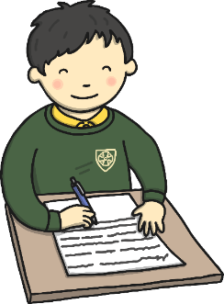
What is the Phonics Screening Check?
Children in Year 1 throughout the country will all be taking part in a phonics screening check during the same week in June. Children in Year 2 will also take the check if they did not achieve the required result when in Year 1 or they have not taken the test before.
The phonics screening check is designed to confirm whether individual children have learnt phonic decoding and blending skills to an age-appropriate standard. This is the end of level 5.
next page

Slide 4
What Happens During the Test?
The test contains 40 words.
Each child will sit 1:1 and read each word aloud to a teacher.
The test will take approximately 10 minutes per child.
The list of words the children read is a combination of 20 real words and 20 pseudo words (nonsense words).
next page

Slide 5
Pseudo Words (Nonsense Words)
The pseudo words will be shown to your child with a picture of an alien.
This provides the children with a context for the pseudo word which is independent from any existing vocabulary they may have.
Pseudo words are included because they will be new to all pupils; they do not favour children with a good vocabulary knowledge or visual memory of words.
next page

Slide 6
Section 1 words
next page

Slide 7
Section 2 words
next page

Slide 8
Reporting to Parents
By the end of the summer term all schools must report each child's results to their parents. They will also confirm if the child has met the standard threshold.
Children who do not achieve the expected level will retake the test when they are in Year 2.
The pass mark has been 32/40 since 2012.
next page

Slide 9
How Can I Help My Child at Home?
Play lots of sound and listening games with your child.
Read as much as possible to and with your child.
Encourage and praise – get them to have a ‘good guess’.
If your child is struggling to decode a word, help them by encouraging them to say each sound in the word from left to right.
Blend the sounds by pointing to each one, e.g. /c/ in cat, /p/ in pat, /ng/ in sing, /ee/ in been. Next move your finger under the whole word as you say it.
Discuss the meaning of words if your child does not know what they have read.
next page

Slide 10
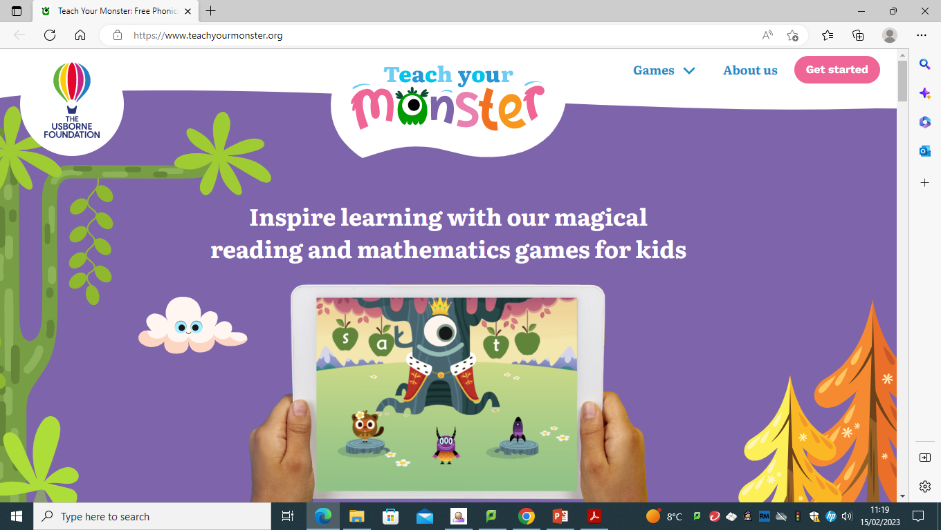
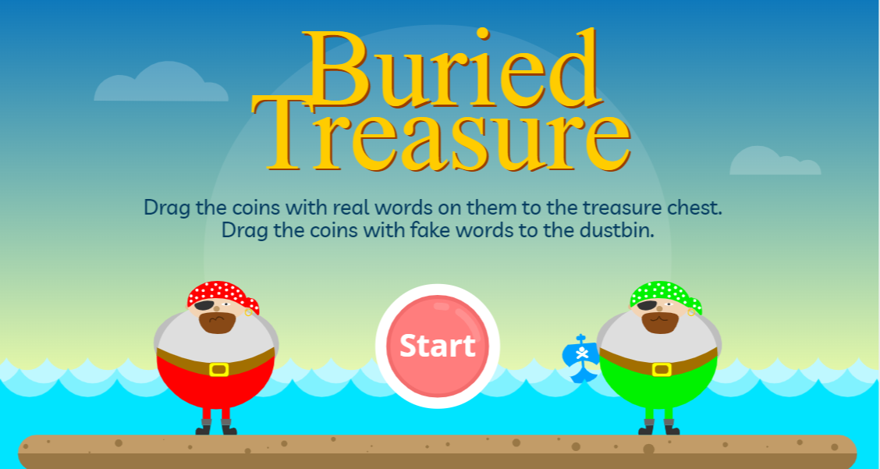
How Can I Help My Child at Home?
Teach you monster to read www.teachyourmonster.org/
Phonics Play https://www.phonicsplay.co.uk/
next page

Slide 11
When is the Phonics Check?
The week commencing Monday 12 June 2023
Please be here!
Many thanks for coming. Please let us know if we can help in any way.
next page

